Slide 1
Advanced Software Engineering Course
Unit Testing
Antonio Di Monaco
Computer Science Bachelor Program

Slide 2
Unit Testing
  What is it and why we do it
  Dummies
  Mocks
  Spies
  Stubs
  Fakes
Coverage
References:
https://docs.junit.org/6.1.3/overview.html
https://javadoc.io/doc/org.mockito/mockito-core/latest/org.mockito/org/mockito/Mockito.html
Test double: any object that replaces a real component in a test

Slide 3
What is Unit Testing ?
Unit testing is a software development technique that focuses on testing individual components of a program,
such as functions, methods, or classes, in isolation from the rest of the application.
A unit is defined as the smallest testable part of an application, typically corresponding to a single
behavior or requirement.
Key characteristics:
Isolation: Testing components independently from external dependencies
Automation: Tests run automatically without manual intervention
Repeatability: Tests produce consistent results across multiple executions
Fast execution: Unit tests should run in milliseconds
FIRST principle:
Fast
Isolated
Repeatable
Self-checking
Timely
Required!
Nice to have
Write tests before or alongside
the production code

Slide 4
Why Unit Testing ?
Early Defect Detection
Unit testing enables developers to catch defects early in the software development process, before code is integrated with other components.
This significantly reduces debugging time and prevents defects from propagating to other parts of the system.
Improved Code Quality
Writing unit tests forces developers to think through design and edge cases, leading to cleaner.
Tests serve as executable specifications that document how code should behave.
Facilitates Refactoring
Unit tests provide a safety net that allows developers to refactor code with confidence can be confident that existing functionality remains intact.
Faster Development Cycles
By catching bugs early and reducing manual testing time, unit testing accelerates the overall development process can iterate quickly and release more frequently.
Better Documentation
Unit tests serve as living documentation, providing concrete examples of how code should be used. New developers can understand functionality by examining test cases.
Reduced Costs
Bugs found during unit testing are much cheaper to fix than bugs discovered later in integration, system testing, or production.
The cost of fixing a bug increases exponentially as it moves through the development lifecycle.

Slide 5
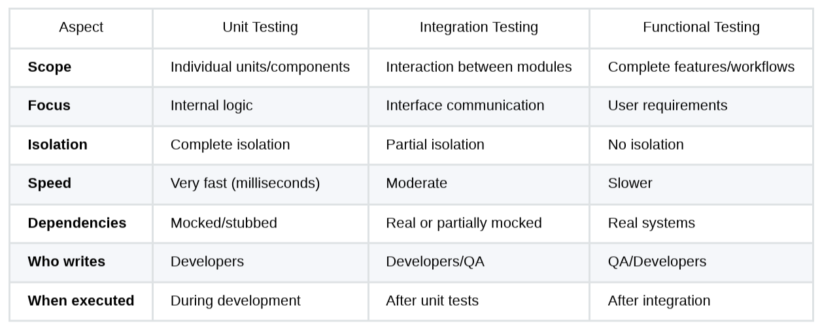
Other types of testing

Slide 6
Anatomy of a Unit Test
Essential Components:
Test ID/Name: Descriptive name indicating what is being tested
Setup (Arrange): Initialize objects and prepare test data
Execution (Act): Execute the code under test
Verification(Assert): Check that results match expectations
Teardown: Clean up resources (if needed)
@Test
public void testAddition() {
// Arrange
Calculator calculator = new Calculator();
int a = 5;
int b = 3;
// Act
int result = calculator.add(a, b);
// Assert
assertEquals(8, result);
}
Arrange–Act–Assert (AAA)
Every test has three phases (also called Given–When–Then).

Slide 7
Testing - Some vocabulary
System Under Test: the object we are actually testing
Depended-On Component: anything the SUT needs to do its job (database, e-mail service, clock).
Test Fixture: the fixed baseline state a test runs against (the arranged objects).
Test Double: any object that stands in for a real DOC during a test — the umbrella term for Dummies, Stubs, Spies, Mocks and Fakes. The name is an analogy to a stunt double in film.

Slide 8
Two ways to verify
State verification: after acting, inspect the state of the SUT (or a Fake) and assert it is correct. "Did the balance become 300?”
Behavior verification: assert that the SUT made the right calls on its collaborators. "Did it call notifyTransfer exactly once with these arguments?"
This distinction is the backbone of the whole test-double taxonomy:
Dummies, Stubs, Fakes and Spies support state verification
Mocks are the tool of behavior verification.

Slide 9
Two ways to approach
Classical / Detroit / classicist style: use real collaborators wherever practical, substitute doubles only for awkward ones (DB, e-mail). Prefers state verification.
Mockist / London style: isolate the SUT from all meaningful collaborators using mocks; drive design outside-in. Prefers behavior verification.
Neither is universally correct - they are trade-offs between test isolation and coupling of tests to implementation detail.

Slide 10
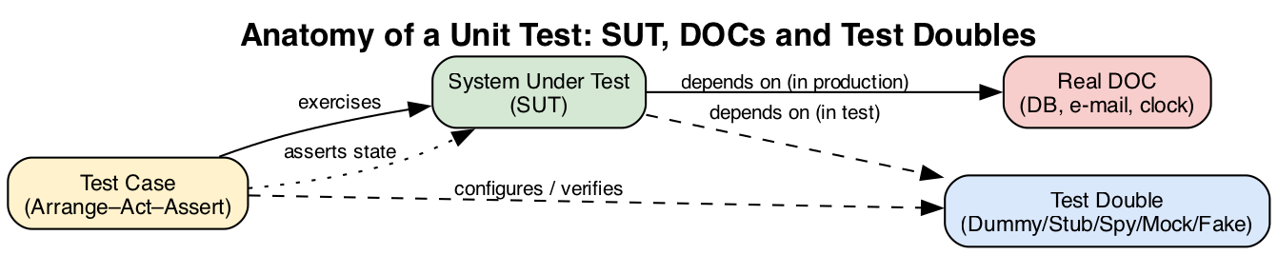
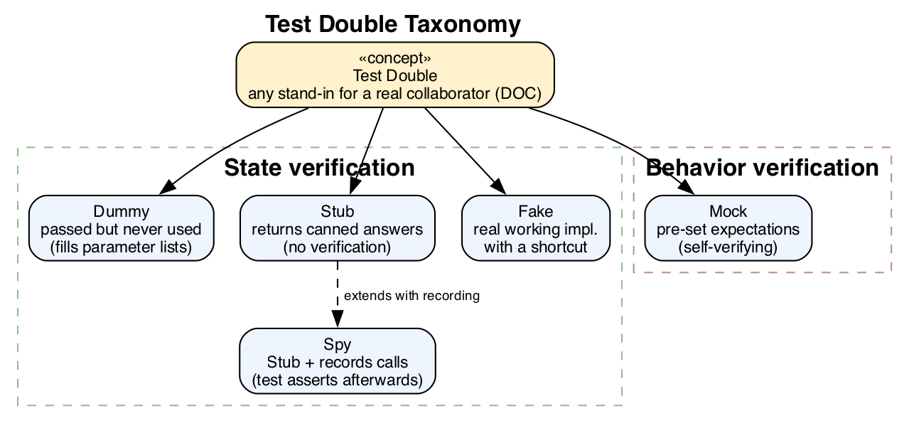
Test Doubles (a.k.a. Dependency Injection)
Test doubles are only possible if the SUT does not hard-create its collaborators.
The SUT must depend on abstractions (interfaces) and receive concrete instances from outside (constructor injection).

Slide 11
Dummies
A Dummy is passed just to satisfy a method or a constructor signature. It exists purely to make the code compile and run.
It does nothing during the test, it’s just passed when a reference is required somewhere but it’s irrelevant for the test. It must not influence the test in any way.
It’s used when we want to avoid nulls or complex setup for unused parameters.

Slide 12
Dummies – Example
public interface Logger {
void info(String message);
void error(String message);
}
Test
import org.junit.jupiter.api.Test;
import static org.junit.jupiter.api.Assertions.*;
public class PaymentServiceTest {
// Dummy implementation that does nothing
private static class DummyLogger implements Logger {
public void info(String message) { /* do nothing */ }
public void error(String message) { /* do nothing */ }
}
@Test
void shouldSucceedForSmallPayments() {
Logger dummy = new DummyLogger();
PaymentService service = new PaymentService(dummy);
boolean result = service.charge("alice", 50.0);
assertTrue(result); // we don’t care about logging
}
}
System under test
public class PaymentService {
private final Logger logger;
public PaymentService(Logger logger) {
this.logger = logger;
}
public boolean charge(String userId, double amount) {
// We're not testing this part, just need to compile
logger.info("Charging " + userId + " for $" + amount);
return amount < 1000; // pretend high amounts fail
}
}
Dummy
Technically a mock
Logger dummy = mock(Logger.class);
can work as well, but avoid using it if you don’t need to verify calls.
Let’s keep the noise at minimum.
Notes:
Which Design Pattern is it?

Slide 13
Mocks
A Mock simulates a real object’s behavior, so we need it to verify behavior, not just return values.
It records the interactions made with it, and fails if expected interations don’t occur.
It must be supported by your language framework.
It’s used when
we want to verify that something was called, and with which parameters
we want to enforce expected interactions

Slide 14
Mocks – Example
Test
import org.junit.jupiter.api.Test;
import static org.mockito.Mockito.*;
public class OrderServiceTest {
@Test
void shouldSendConfirmationEmailWhenOrderIsPlaced() {
// Arrange
EmailSender mockEmailSender = mock(EmailSender.class); // Create the mock
OrderService service = new OrderService(mockEmailSender);
// Act
service.placeOrder("bob@example.com", 99.0);
// Assert
verify(mockEmailSender).send("bob@example.com", "Order placed: $99.0");
}
}
public interface EmailSender {
void send(String to, String message);
}
Mock
public class Order {
public final String userId;
public final double amount;
public Order(String userId, double amount) {
this.userId = userId;
this.amount = amount;
}
}
System under test
public class OrderService {
private final EmailSender emailSender;
public OrderService(EmailSender emailSender) {
this.emailSender = emailSender;
}
public void placeOrder(String userId, double amount) {
// Imagine this saves the order...
emailSender.send(userId, "Order placed: $" + amount);
}
}
// Check that it was called only once
verify(mockEmailSender, times(1)).send(...);
// Check it was never called
verify(mockEmailSender, never()).send(anyString(), anyString());
// Capture arguments (advanced)
ArgumentCaptor<String> captor = ArgumentCaptor.forClass(String.class);
verify(mockEmailSender).send(captor.capture(), anyString());
assertEquals("bob@example.com", captor.getValue());
Use mocks only for dependencies => do not mock your own logic!
Notes:
In which other way could we have implemented this?

Slide 15
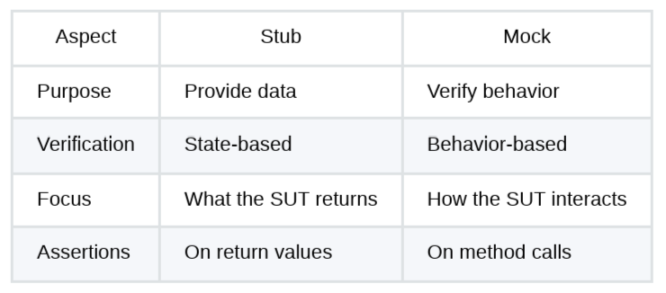
Stubs
A Stub returns predefined values to method calls.
It helps isolate the unit under test from unpredictable dependencies.
It has no logic, just fixed behavior, does not record any usage.
It can be supported by your language framework, but it allows also a manual implementation, or be implemented
via a mock that just returns a value.
It’s used when
we want to simulate fixed response from services (network, DB, ...) => makes test faster, deterministic
and repeatable
we want to bypass external systems or complex logic

Slide 16
Stubs – Example
import org.junit.jupiter.api.Test;
import static org.mockito.Mockito.*;
import static org.junit.jupiter.api.Assertions.*;
public class CheckoutServiceTest {
@Test
void shouldSendEmailIfPaymentSucceeds() {
// Arrange: Stub payment to succeed
PaymentGateway stubGateway = mock(PaymentGateway.class);
when(stubGateway.charge(anyString(), anyDouble())).thenReturn(true);
EmailSender mockEmailSender = mock(EmailSender.class); // not the test focus!
CheckoutService service = new CheckoutService(stubGateway, mockEmailSender);
// Act
boolean result = service.checkout("alice@example.com", 50.0);
// Assert
assertTrue(result);
verify(mockEmailSender).send("alice@example.com", "Payment received: $50.0");
}
@Test
void shouldNotSendEmailIfPaymentFails() {
// Arrange: Stub payment to fail
PaymentGateway stubGateway = mock(PaymentGateway.class);
when(stubGateway.charge(anyString(), anyDouble())).thenReturn(false);
EmailSender mockEmailSender = mock(EmailSender.class); // not the focus
CheckoutService service = new CheckoutService(stubGateway, mockEmailSender);
// Act
boolean result = service.checkout("bob@example.com", 75.0);
// Assert
assertFalse(result);
verify(mockEmailSender, never()).send(anyString(), anyString());
}
}
public interface PaymentGateway {
boolean charge(String userId, double amount);
}
Stub
public interface EmailSender {
void send(String to, String message);
}
System under test
public class CheckoutService {
private final PaymentGateway paymentGateway;
private final EmailSender emailSender;
public CheckoutService(PaymentGateway paymentGateway,
EmailSender emailSender) {
this.paymentGateway = paymentGateway;
this.emailSender = emailSender;
}
public boolean checkout(String userId, double amount) {
boolean success = paymentGateway.charge(userId, amount);
if (success) {
emailSender.send(userId, "Payment received: $" + amount);
}
return success;
}
}
Don’t misuse stubs, if you need to check if a method has been called,
use mocks or spies.
Test

Slide 17
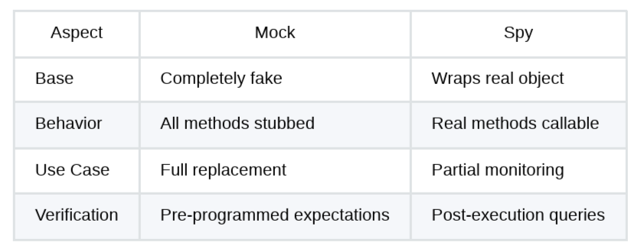
Spies
A Spy wraps around a real object.
It records the interactions made with it: method calls, parameters, number of invocations.
=> looks like Mock, but it’s used to verify interactions with a real object
It must be supported by your language framework.
It’s used when
we want to observe real behavior AND verify interactions (mocks just check the second one)
we are working with stateful dependencies, potentially hard to mock

Slide 18
Spies – Example
import org.junit.jupiter.api.Test;
import static org.mockito.Mockito.*;
import static org.junit.jupiter.api.Assertions.*;
public class OrderServiceTest {
@Test
void shouldSendEmail_usingRealSenderSpy() {
// Arrange
RealEmailSender realSender = new RealEmailSender();
EmailSender spySender = spy(realSender); // <-- Spy wraps real object
OrderService service = new OrderService(spySender);
// Act
service.placeOrder("bob@example.com", 88.0);
// Assert: verify the method was called
verify(spySender).send("bob@example.com", "Your order for $88.0 is confirmed");
// Assert: check the real method executed
assertEquals(1, realSender.getSentEmails().size());
assertTrue(realSender.getSentEmails().get(0).contains("bob@example.com"));
}
}
public interface EmailSender {
void send(String to, String message);
}
Spy
public class RealEmailSender implements EmailSender {
private final List<String> sentEmails = new ArrayList<>();
@Override
public void send(String to, String message) {
sentEmails.add(to + " => " + message);
// Imagine this sends a real email...
}
public List<String> getSentEmails() {
return new ArrayList<>(sentEmails);
}
}
This is not a mock:
we’re sending email for real!
This is a real implementation,
not a fake one!!
public class OrderService {
private final EmailSender emailSender;
public OrderService(EmailSender emailSender) {
this.emailSender = emailSender;
}
public void placeOrder(String userId, double amount) {
emailSender.send(userId, "Your order for $" + amount + " is confirmed");
}
}
System under test
Test

Slide 19
Fakes
A Fake is working implementation of a dependency.
As such, it’s a test implementation of an interface, intended to be faster and/or safer and/or easier to control.
It’s used when
we need to avoid expensive or unsafe real dependencies (databases, real production systems access,
file systems, network services, etc.)
we need a realistic logic, not just hardcoded inputs and/or returns
It cannot be used when
we need to test a method against exact inputs and/or output
we need to simulate failures or exceptions
when the logic is too complex or hard to replicate
Don’t fake when you can stub
or mock easily =>
fakes can be overengineering

Slide 20
import java.util.ArrayList;
import java.util.List;
public class FakeOrderRepository implements OrderRepository {
private final List<Order> orders = new ArrayList<>();
@Override
public void save(Order order) {
orders.add(order);
}
@Override
public Order findLast() {
return orders.isEmpty() ? null : orders.get(orders.size() - 1);
}
public int count() {
return orders.size();
}
public List<Order> getAll() {
return new ArrayList<>(orders);
}
}
Fakes – Example
Fake
public interface OrderRepository {
void save(Order order);
Order findLast();
}
public class Order {
public final String userId;
public final double amount;
public Order(String userId, double amount) {
this.userId = userId;
this.amount = amount;
}
}
Test
System under test
import org.junit.jupiter.api.Test;
import static org.junit.jupiter.api.Assertions.*;
public class OrderServiceTest {
@Test
void savesOrderToFakeRepository() {
// Arrange
FakeOrderRepository repo = new FakeOrderRepository();
OrderService service = new OrderService(repo);
// Act
service.placeOrder("alice@example.com", 42.0);
// Assert
assertEquals(1, repo.count());
Order saved = repo.findLast();
assertEquals("alice@example.com", saved.userId);
assertEquals(42.0, saved.amount);
}
}
public class OrderService {
private final OrderRepository repository;
public OrderService(OrderRepository repository) {
this.repository = repository;
}
public void placeOrder(String userId, double amount) {
Order order = new Order(userId, amount);
repository.save(order);
}
}

Slide 21
When to use each Test Double type
Scenario | Recommended Type | Reasoning
Parameter required but not used | Dummy | Simplest solution
Need specific return values | Stub | Provides necessary data
Need realistic behavior without full complexity | Fake | Working behavior but simplified
Verify method was called | Mock | Behavior verification
Track calls to real implementation | Spy | Partial mocking
Testing error handling | Stub/Mock | Control exception throwing
Slow external dependency | Fake/Stub | Avoid performance hit
Verify call order matters | Mock | Interaction verification

Slide 22
Code Coverage
Code coverage is a metric that measures the percentage of source code executed during testing.
Identify gaps: Find code not exercised by tests
Measure completeness: Assess test suite comprehensiveness
Guide testing efforts: Focus on untested areas
Track progress: Monitor testing improvements over time
IMPORTANT
High code coverage does NOT guarantee high code quality!!!
A high percentage only indicates which code was executed, not whether it was tested correctly.
public int divide(int a, int b) {
return a / b;
}
@Test public void testDivision() {
assertEquals(6, divide(12, 2));
}
100% code coverage... not properly tested!
(division by zero missing)

Slide 23
Code Coverage - Types
Line Coverage
Percentage of executable statements executed during testing
Branch Coverage
Measures whether each decision point (if/else, switch) has been executed for both true and false conditions
Function Coverage
Measures the percentage of functions/methods called at least once
Condition Coverage
Ensures each Boolean sub-expression is evaluated to both true and false
Path Coverage
Measures whether all possible execution paths through the code are tested
Loop Coverage
Measures whether all possible execution paths through the code are tested

Slide 24
Unit Testing - Example

Slide 25
Wrap-up
Test should be F.I.R.S.T.
Follow the A.A.A. pattern
Test edge cases and boundaries => do not test only happy paths!
Do not cover 100% if not needed => 80% is often sufficient => write tests to find bugs, not to hit percentages
Coverage as a guide, not a goal => Focus on critical code
Use Bridge Design Pattern => it helps you use the Test Doubles via Dependency Injection (= design pattern
where dependencies are provided to a class from the outside rather than created internally).

